Slide 1
Learning Materials Class VIII – Exponents and Radicals

Slide 2
CHAPTER TEXTBOOK LINK
WEB LINK-
https://drive.google.com/file/d/1J0nbh5q6o-VXmZTV44IuHh20RNIJC4rX/view

Slide 3
OBJECTIVES
Understanding radicand, radicals and index
Understanding the relationship between radical and exponential form
Representing positive rational numbers as exponents
Representing negative rational numbers as exponents
Understanding and applying laws of rational exponents

Slide 4
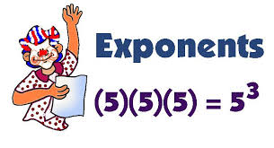
Introduction to Exponents
Exponent is a shortcut for showing repeated multiplication. For example, 2⁵ = 2 × 2 × 2 × 2 × 2 = 32
2 is called the base and 5 is called the ’exponent’ or ‘power’.
2⁵ can be read as "2 raised to the fifth power" or "2 raised to the power 5" or "2 raised by the exponent of 5”.
When exponent is zero
If the exponent is 0 then the answer is always 1. For example, 9⁰ = 1, 21⁰ = 1
Question: What if both the base and exponent are zero, i.e. what is the value of 0⁰?
Answer: Such a form is “undefined”.

Slide 5
Activity
https://www.youtube.com/watch?v=Wm-VFB8dZQA

Slide 6
When exponents are negative….
When the exponent of a non-zero base is negative, we convert it into positive as:
(10)⁻² = $\frac{1}{102}$
(5)⁻⁴ = $\frac{1}{54}$
The reverse is also true:
(10)² = $\frac{1}{{\left(10\right)}^{−2}}$
(5)⁴ =$\frac{1}{{\left(5\right)}^{−4}}$

Slide 7
Understanding radicand, radicals and index
VIDEO LINK:
(Explanation by teacher)
https://youtu.be/4QgJKEin1QA

Slide 8
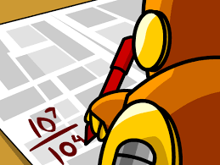
Terms related to Radicals
Given a^{m/n} = $\sqrt[n]{am}$
Here,
$\sqrt[n]{am}$ is the ‘Radical’
is called the Radical Sign
a^{m} is called the ‘Radicand’
‘n’ is called the ‘index of radical’ (and is always a positive integer)

Slide 9
n is the index and is always positive
a^{m} is radicand
is radical

Slide 10
When Exponents are positive rational numbers…
When a positive rational number ‘a’ has exponent in fractional form ‘m/n’ (where ‘m’ and ‘n’ are positive integers), the numerator ‘m’ is called the ‘power’ of ‘a’, while the denominator ‘n’ is called the ‘radical’ or ‘root’
. a ^{m/n}= ${\left(a^{m}\right)}^{\frac{1}{n}}$= n^{th} root of a^{m} = $\sqrt[n]{am}$
(124)^{3/2}can be written as Square Root of (124)³
(124)^{4/3} can be written as Cube Root of (124)⁴
$\sqrt{4}=2$ can be written as 4^{½} = 2
$\sqrt[3]{8}=2$ can be written as 8^{1/3} = 2

Slide 11
When Exponents are negative rational numbers…
When ‘a’ is a positive rational number and ‘m’, ‘n’ are positive integers,
a^{-m/n} = $\frac{1}{a^{\frac{m}{n}}}$ = $\frac{1}{{(a^{m})}^{\frac{1}{n}}}$= $\frac{1}{\sqrt[n]{am}}$
e.g.
(64)^{-2/3} = $\frac{1}{{(64)}^{\frac{2}{3}}}$ = $\frac{1}{{(({64)}^{2})}^{\frac{1}{3}}}$= $\frac{1}{\sqrt[3]{642}}$ ⁼$\frac{1}{\sqrt[3]{64x64}}$ = $\frac{1}{\sqrt[3]{4x4x4x4x4x4}}$= $\frac{1}{4 x 4}$ = $\frac{1}{16}$
Note: a^{-m/n} is the Multiplicative Inverse or Reciprocal of a^{m/n}, or a^{-m} is the Multiplicative Inverse or Reciprocal of a^{m}.

Slide 12
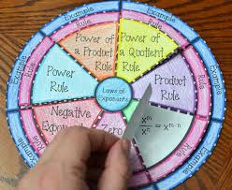
Laws of Rational Exponents
$x^{a}$ x $x^{b}$= $x^{a+b}$
$x^{a}$ ÷ $x^{b}$= $x^{a−b}$
${\left(x^{a}\right)}^{b}$ = $x^{ab}$
$x^{a}$ x $y^{a}$= ${\left(xy\right)}^{a}$
${\left(\frac{x}{y}\right)}^{a}$ = $\frac{x^{a}}{y^{a}}$
Art Integration

Slide 13
Law 1: $x^{a}$ x $x^{b}$= $x^{a+b}$
When x is a positive rational number, and a,b are any rational numbers, we use this law as:
2³ x 2⁶ = 2⁶⁺³ = 2⁹
7³ x 7⁻⁶ = 7³⁺⁽⁻⁶⁾ = 7⁻³ = $\frac{1}{7^{3}}$ = $\frac{1}{343}$
${\left(\frac{4}{5}\right)}^{3}$ x ${\left(\frac{4}{5}\right)}^{4}$ x ${\left(\frac{4}{5}\right)}^{−2}$ = ${\left(\frac{4}{5}\right)}^{3+4+(−2)}$ = ${\left(\frac{4}{5}\right)}^{7−2}$ = ${\left(\frac{4}{5}\right)}^{5}$
$6^{\frac{2}{3}}$ x $6^{\frac{1}{2}}$ x $6^{\frac{−1}{6}}$ = $6^{\frac{2}{3}+\frac{1}{2}+\frac{−1}{6}}$ = $6^{\frac{4+3−1}{6}}$ = $6^{\frac{6}{6}}$ = 6¹ = 6

Slide 14
Law 2: $x^{a}$ ÷ $x^{b}$= $x^{a−b}$
When x is a positive rational number, and a,b are any rational numbers, we use this law as:
2⁶ ÷ 2³ = 2⁶⁻³ = 2³ = 8
2³ ÷ 2⁶ = 2³⁻⁶ = 2⁻³ = $\frac{1}{2^{3}}$= $\frac{1}{8}$
${\left(\frac{4}{5}\right)}^{3}$÷ ${\left(\frac{4}{5}\right)}^{4}$ = ${\left(\frac{4}{5}\right)}^{3−4}$ = ${\left(\frac{4}{5}\right)}^{−1}$ = $\frac{5}{4}$
$6^{\frac{2}{3}}$ ÷ $6^{\frac{1}{9}}$ = $6^{\frac{2}{3}−\frac{1}{9}}$ = $6^{\frac{6−1}{9}}$ = $6^{\frac{5}{9}}$

Slide 15
Law 3: ${\left(x^{a}\right)}^{b}$ = $x^{ab}$
When x is a positive rational number, and a,b are any rational numbers, we use this law as:
${\left(5^{4}\right)}^{3}$ = $5^{4x3}$= $5^{12}$
${\left({\left(\frac{2}{3}\right)}^{3}\right)}^{−2}$ = ${\left(\frac{2}{3}\right)}^{3 x (−2)}$=${\left(\frac{2}{3}\right)}^{−6}$= ${\left(\frac{3}{2}\right)}^{6}$
${\left(7^{\frac{3}{2}}\right)}^{4}$ = $7^{\frac{3}{2}x4}$ = $7^{3x2}$ = $7^{6}$

Slide 16
Law 4: $x^{a}$ x $y^{a}$= ${\left(xy\right)}^{a}$
When x, y are positive rational numbers, and a is any rational number, we use this law as:
5⁴ x 2⁴ = ${\left(5x2\right)}^{4}$= ${10}^{4}$
${\left(\frac{2}{3}\right)}^{−2}$ x ${\left(\frac{9}{4}\right)}^{−2}$= ${\left(\frac{2}{3} x \frac{9}{4}\right)}^{−2}$=${\left(\frac{3}{2}\right)}^{−6}$ = ${\left(\frac{2}{3}\right)}^{6}$
$\sqrt{2}$ x $\sqrt{8}$ = $2^{\frac{1}{2}}$ x $8^{\frac{1}{2}}$ = ${16}^{\frac{1}{2}}$ = $\sqrt{16}$ = 4

Slide 17
Law 5: ${\left(\frac{x}{y}\right)}^{a}$ = $\frac{x^{a}}{y^{a}}$
When x, y are positive rational numbers, and a is any rational number, we use this law as:
${\left(\frac{3}{2}\right)}^{4}$ = $\frac{3^{4}}{2^{4}}$
${\left(\frac{2}{3}\right)}^{−5}$ = $\frac{2^{−5}}{3^{−5}}$ = $\frac{3^{5}}{2^{5}}$ or ${\left(\frac{2}{3}\right)}^{−5}$ =${\left(\frac{3}{2}\right)}^{5}$= $\frac{3^{5}}{2^{5}}$
${\left(\frac{6}{7}\right)}^{\frac{5}{7}}$ = $\frac{6^{\frac{5}{7}}}{7^{\frac{5}{7}}}$
$\sqrt{\frac{16}{25}}$ = ${\left(\frac{16}{25}\right)}^{\frac{1}{2}}$ = $\frac{{16}^{\frac{1}{2}}}{{25}^{\frac{1}{2}}}$ = $\frac{\sqrt{16}}{\sqrt{25}}$ = $\frac{4}{5}$

Slide 18
KEY POINTS
If n is a positive integer greater than 1 and a,b are rational number such that
b^{n} = a, then we write $a^{\frac{1}{n}}$ = b.
2. $a^{\frac{1}{n}}$ is called the nth root of a and may be written as $\sqrt[n]{a}$ .
3. For any positive integer m and n, and any non-zero rational number a, we define.
$a^{\frac{m}{n}}$ = $\sqrt[n]{a^{m}}$ and $a^{−\frac{m}{n}}$ = $\sqrt[n]{a^{−m}}$ = $\sqrt[n]{a^{−m}}$= $\frac{1}{\sqrt[n]{a^{m}}}$
4. If a is any rational number different from zero and x,y are any rational numbers, then
(i) $a^{x}$ X $a^{y}$ = $a^{x+y}$ (ii) $a^{x}$ ÷ $a^{y}$ = $a^{x−y}$ (iii) ${{(a}^{x})}^{y}$ = $a^{xy}$
5. If a=$\sqrt[n]{b }$ = $b^{\frac{1}{n}}$, then $b^{\frac{1}{n}}$ is the exponential form and $\sqrt[n]{b}$ is the radical from of a, n is the index the radical and b is the radicand.

Slide 19
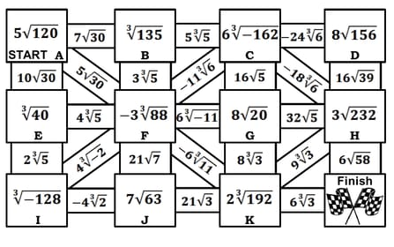
ACTIVITY (HELP THE BOY TO WIN)

Slide 20
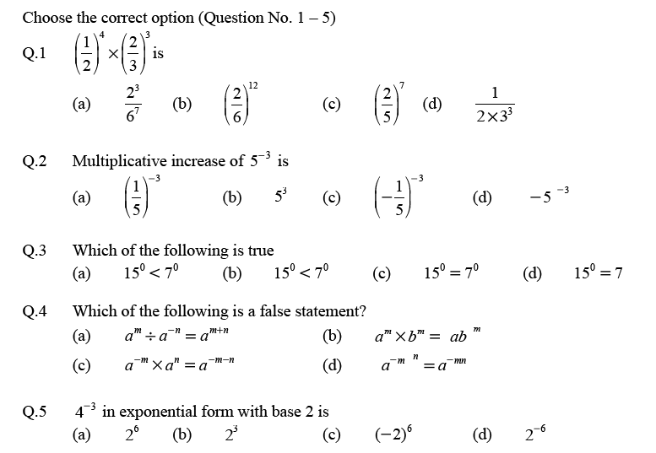
ASSIGNMENT

Slide 21
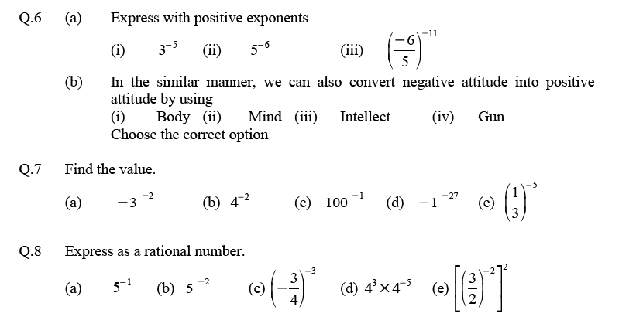

Slide 22
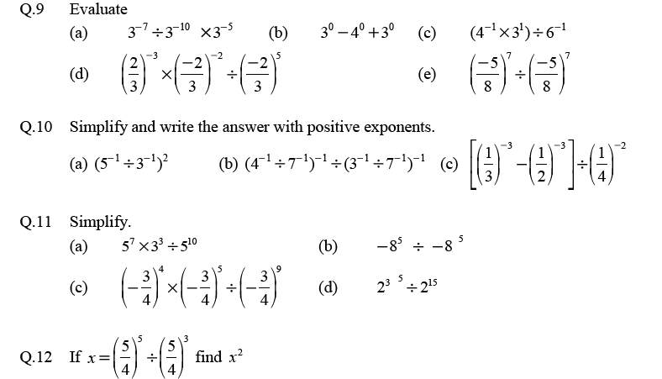

Slide 23
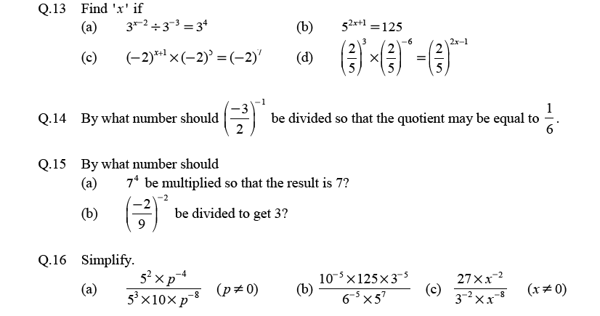

Slide 24
PROJECT WORK (ART INTEGRATION)
Prepare a hand book containing laws of exponents. (Just like a formula book)

Slide 25
Let’s have a quick review
Exponents and Radicals
Radicals
a^{-n} = $\frac{1}{a^{n}}$
a^{-n} = 1/𝑎^𝑛
a^{-m/n} = $\frac{1}{a^{\frac{m}{n}}}$ = $\frac{1}{{(a^{m})}^{\frac{1}{n}}}$ = $\frac{1}{\sqrt[n]{am}}$
a^{-m/n} = □(64&1/𝑎^□(64&𝑚/𝑛) ) = 1/〖(𝑎^𝑚)〗^□(64&1/𝑛) = 1/√(𝑛&𝑎^{𝑚)}
a⁰=1
Laws of Exponents
${\left(x^{a}\right)}^{b}$ = $x^{ab}$
$x^{a}$ x $x^{b}$= $x^{a+b}$
is the Radical Sign
$\sqrt[n]{am}$ is ‘Radical’
$x^{a}$ ÷ $x^{b}$= $x^{a−b}$
a^{m/n} = $\sqrt[n]{am}$
= ${\left(a^{m}\right)}^{\frac{1}{n}}$ (n^{th} root of a^{m})
$x^{a}$ x $y^{a}$= ${\left(xy\right)}^{a}$
${\left(\frac{x}{y}\right)}^{a}$ = $\frac{x^{a}}{y^{a}}$
‘n’ is the ‘index of radical’
a^{m} is the ‘Radicand’

